Slide 1
Generative Adversarial Networks
By: Ian Goodfellow
Presented by: Janusan Baskararajah

Slide 2
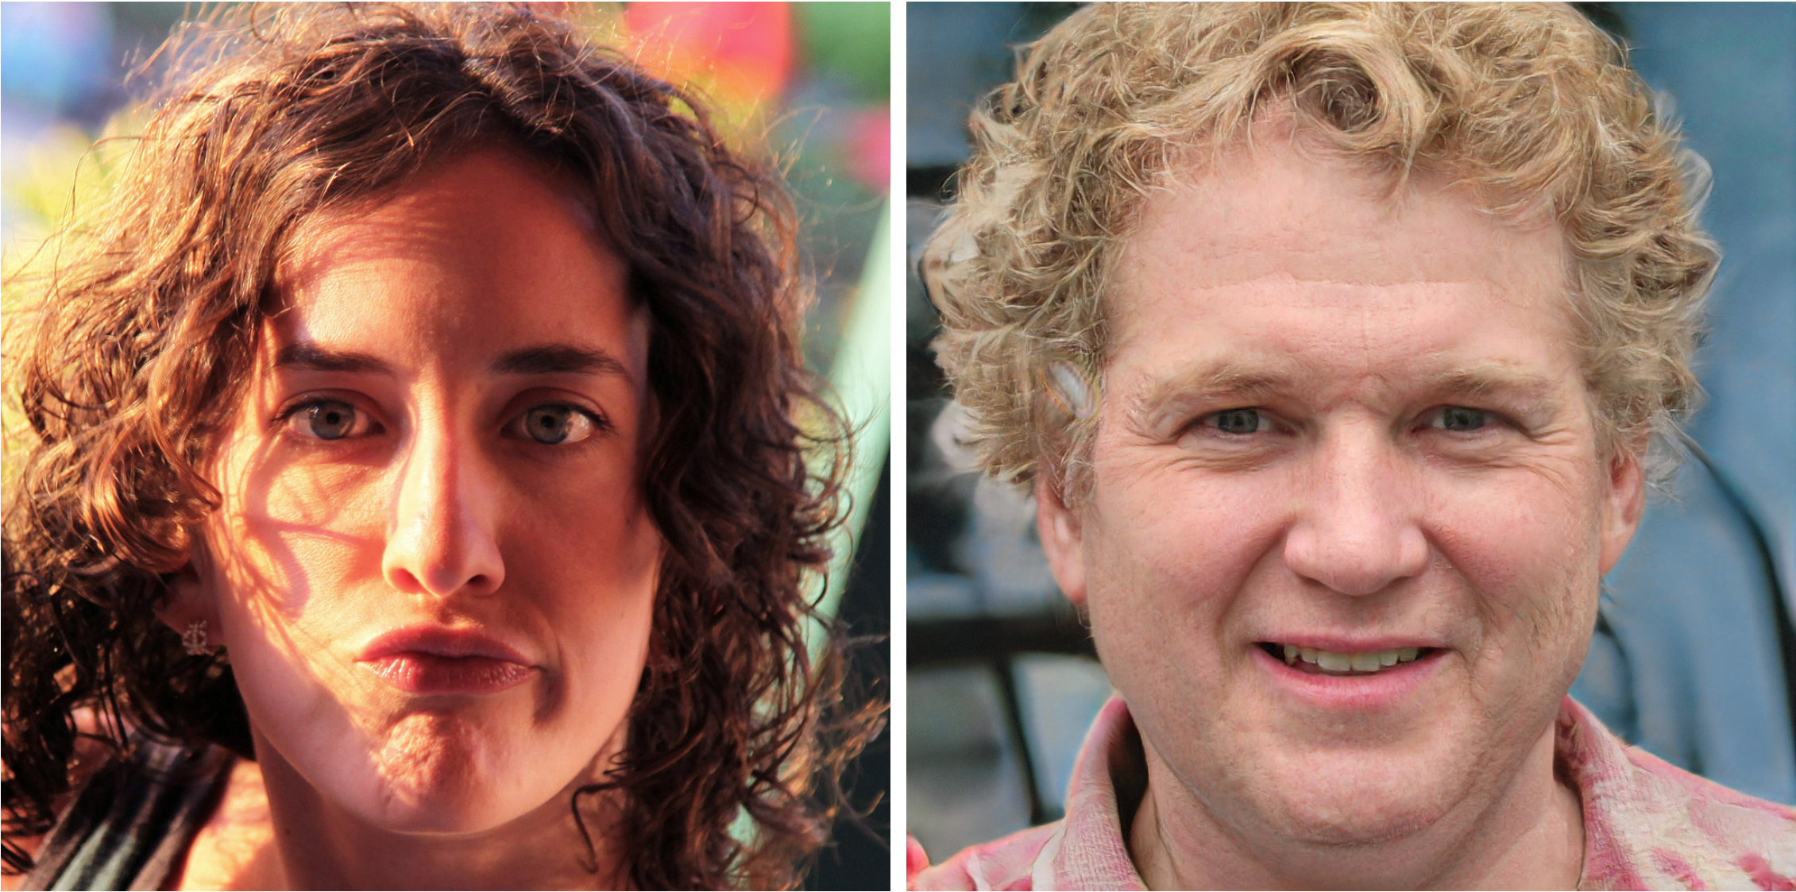
Guess which is a Real Image
FAKE
whichfaceisreal.com

Slide 3
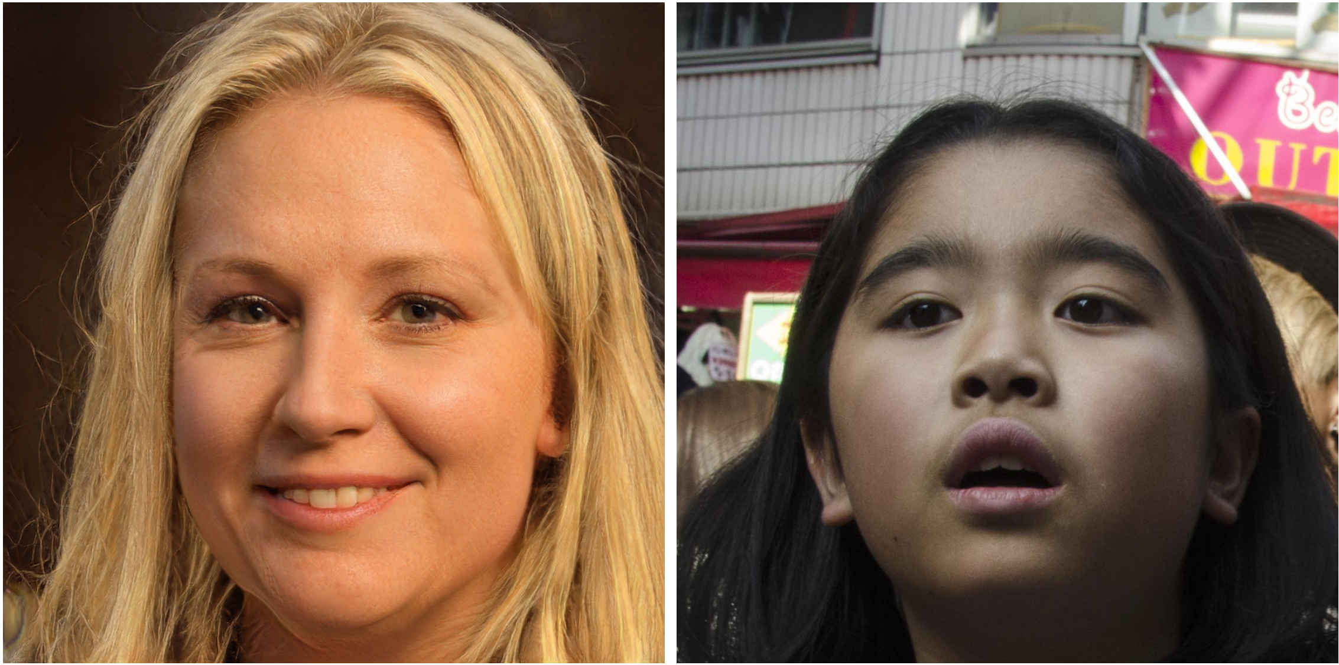
Guess which is a Real Image
FAKE
whichfaceisreal.com

Slide 4
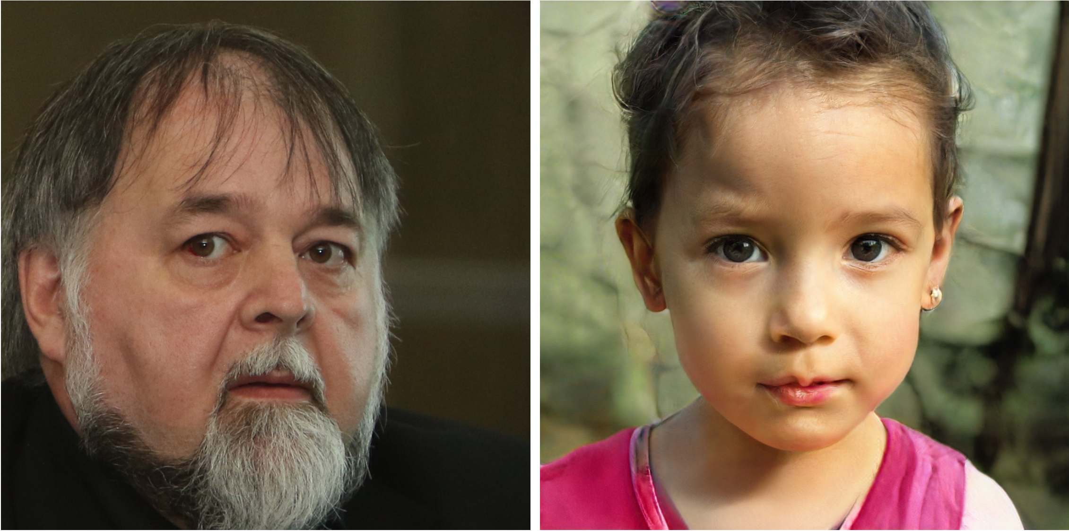
Guess which is a Real Image
FAKE
whichfaceisreal.com

Slide 5
Generative Adversarial Networks
By: Ian J. Goodfellow, Jean Pouget-Abadie, Mehdi Mirza, Bing Xu, David Warde-Farley, Sherji lOzair, Aaron Courville, Yoshua Bengio
Presented by: Janusan Baskararajah

Slide 6
Presentation Outline
Motivation/Previous Challenges
Multilayer Perceptrons
Dive into Adversarial Networks
Experimental Results
Analogy
Future Work/Since 2014
Interesting outcomes due to GANs
Implications of GANs

Slide 7
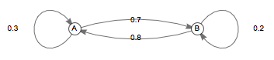
Challenges in the Field – Generational Models
Previous models are Computational Expensive due to (intractable) log-likelihood functions and thus must be approximated to the likelihood gradient
Motivated work into “Generative Machines”
One example: Generative Stochastic Networks (GSNs)
Backpropagation is used to train the generator model
Other work in the field looked into the use of Variational Auto Encoders
https://brilliant.org/wiki/markov-chains/

Slide 8
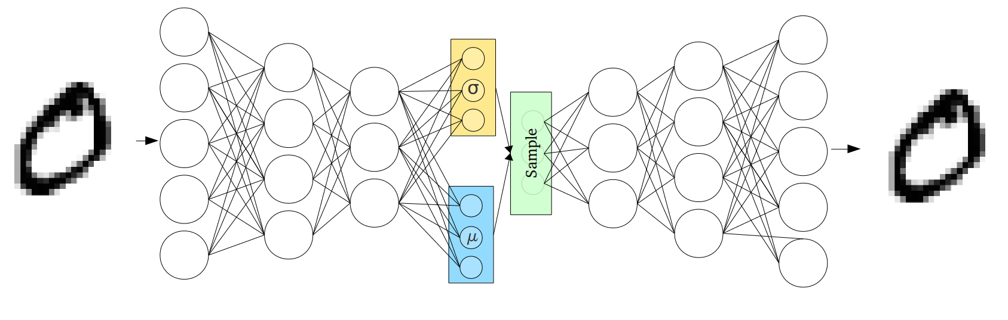
Variational Auto Encoders
https://towardsdatascience.com/intuitively-understanding-variational-autoencoders-1bfe67eb5daf

Slide 9
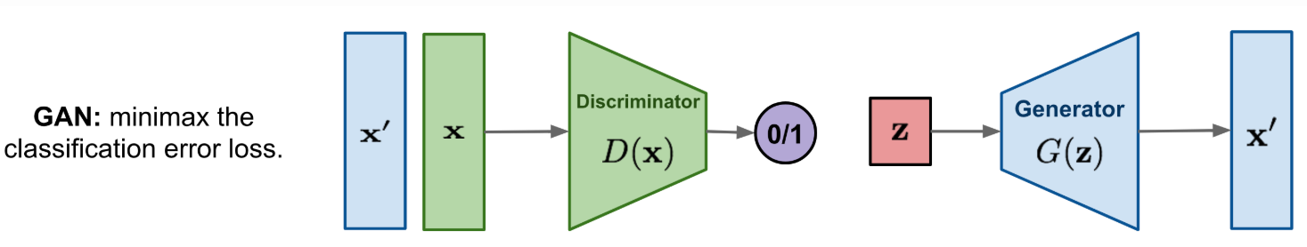
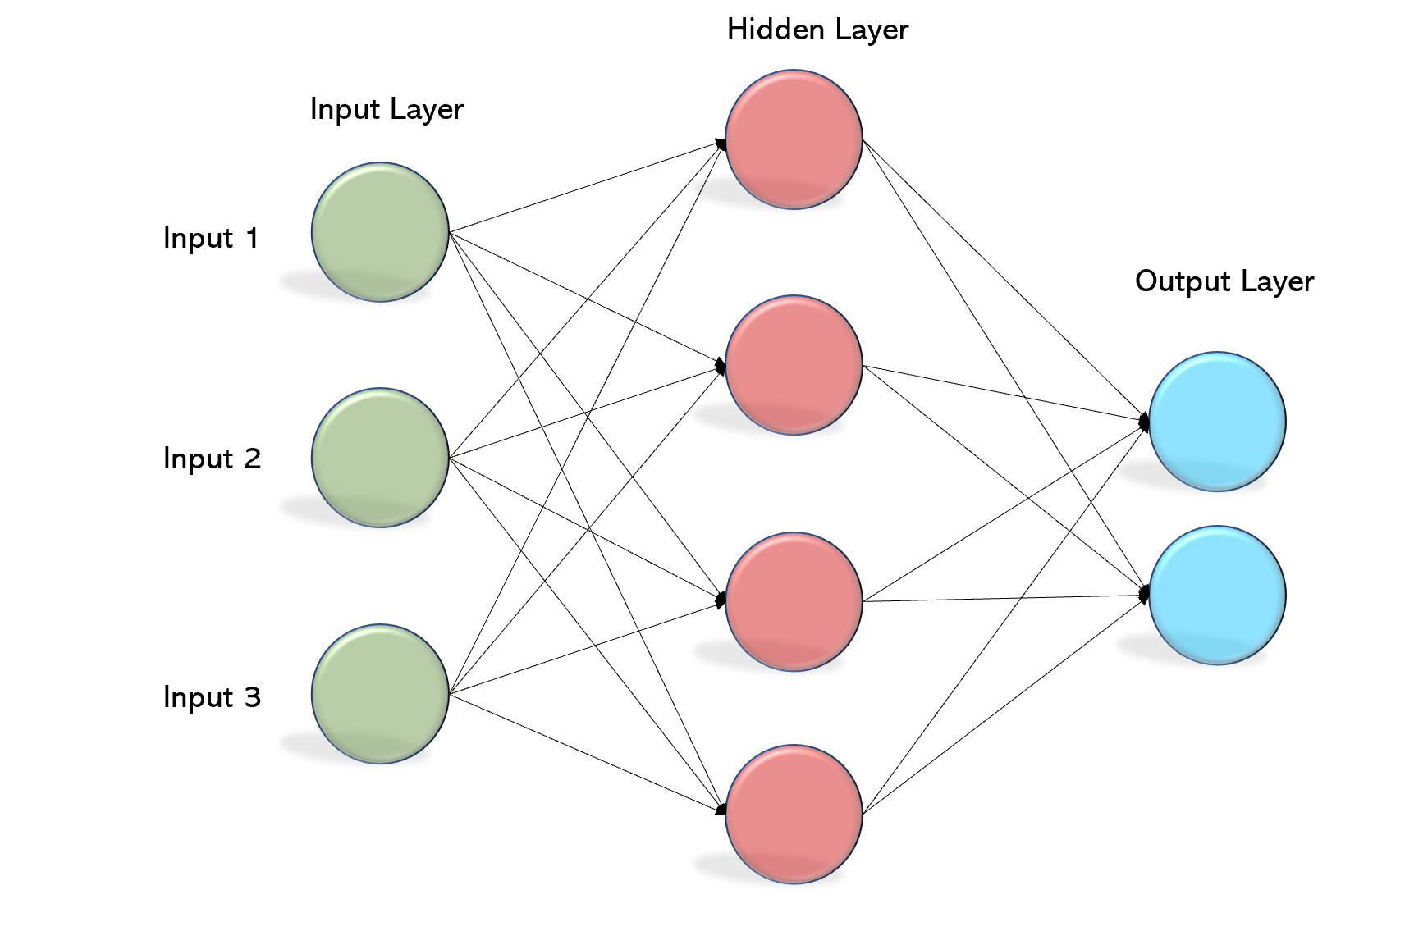
Multilayer Perceptrons
Discriminator
Generator
https://becominghuman.ai/multi-layer-perceptron-mlp-models-on-real-world-banking-data-f6dd3d7e998f https://lilianweng.github.io/lil-log/2018/10/13/flow-based-deep-generative-models.html

Slide 10
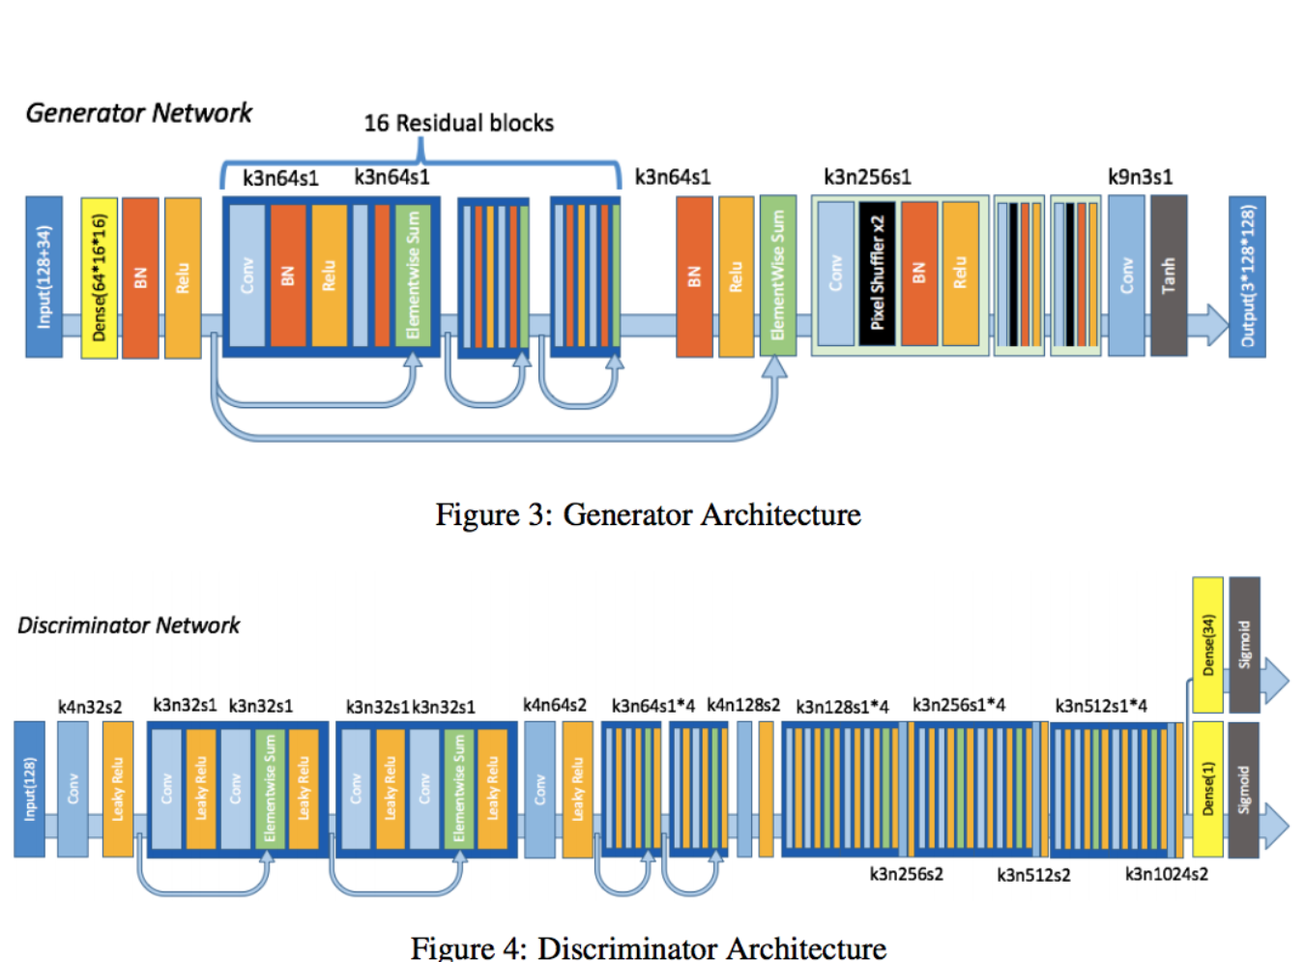
GAN Architecture
Both Generator and Discriminator composed of many layers of convolutional layers, batch normalization and ReLu with skip connections
Jin et al., 2017

Slide 11
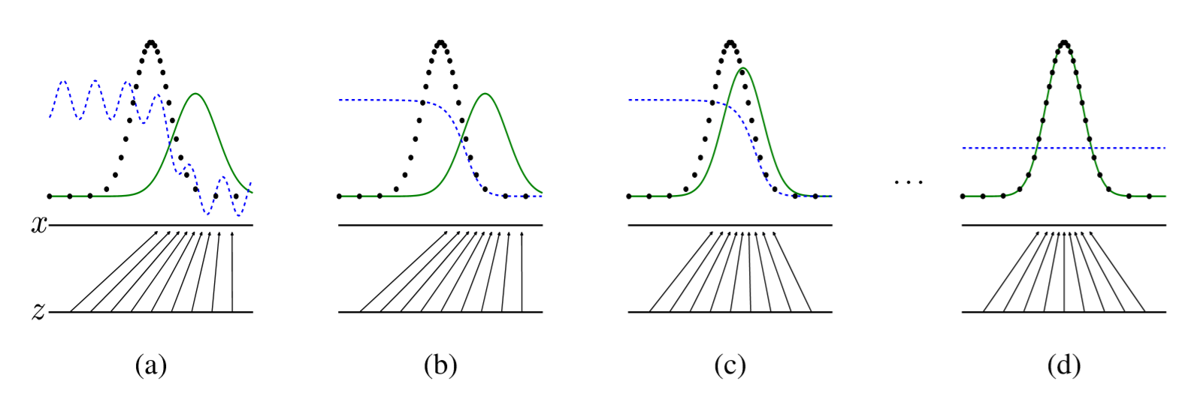

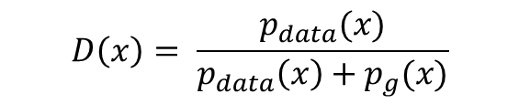
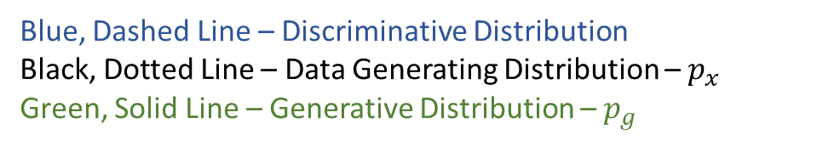
Adversarial Nets
Blue, Dashed Line – Discriminative Distribution
Black, Dotted Line – Data Generating Distribution – $p_{x}$
Green, Solid Line – Generative Distribution – $p_{g}$
Two-Player minmax game
Players are:
G – Generator
D – Discriminator
D is playing to determine if $x$ came from True Data or the Generator
$$D\left(x\right)= \frac{p_{data}(x)}{p_{data}\left(x\right)+p_{g}(x)}$$

Slide 12
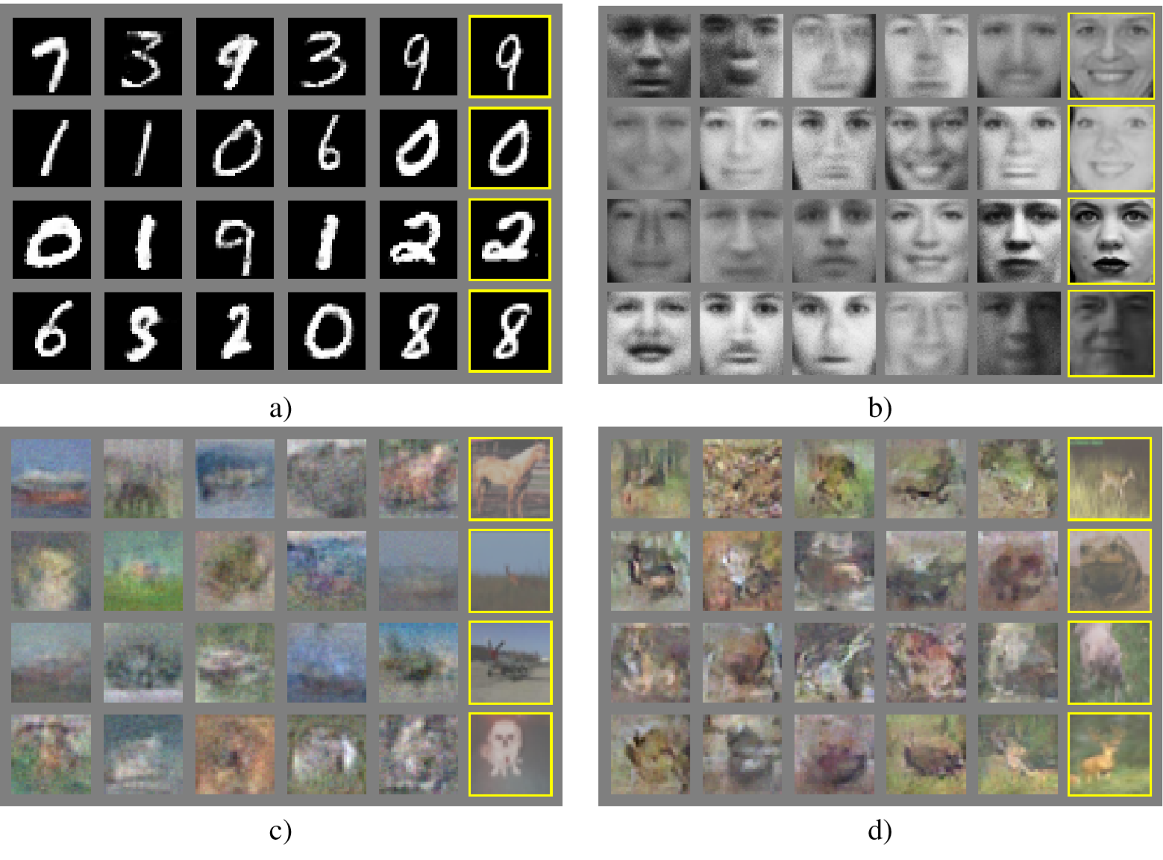
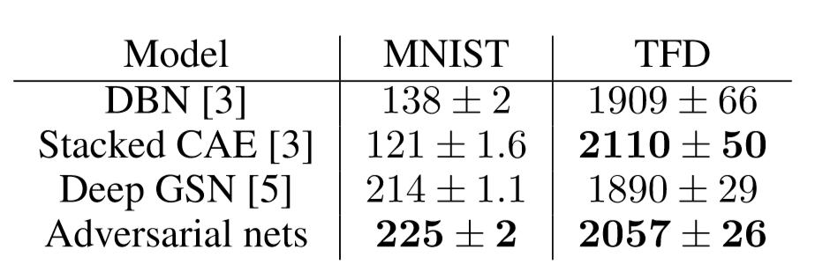
Experimental Results

Slide 13


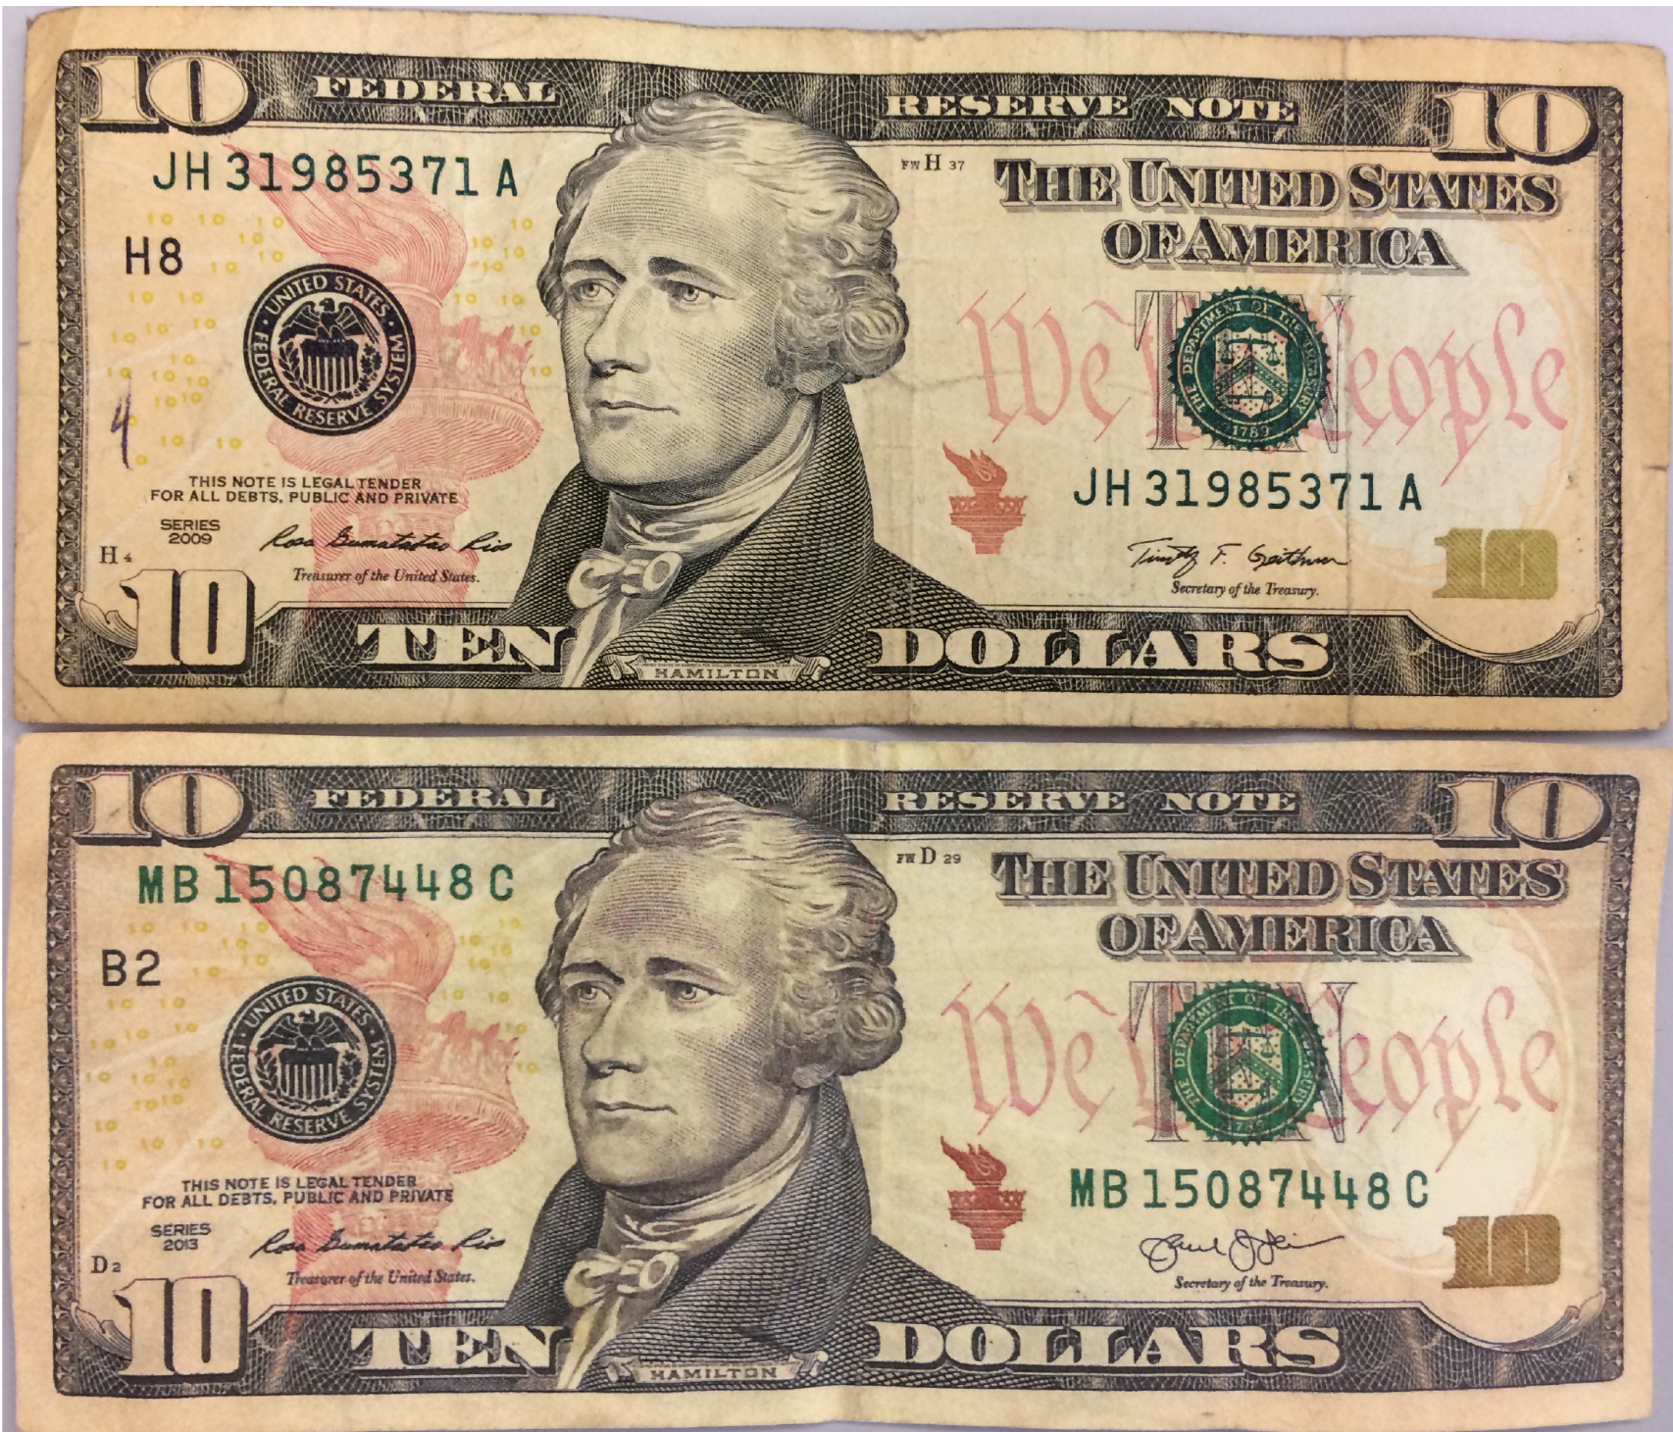
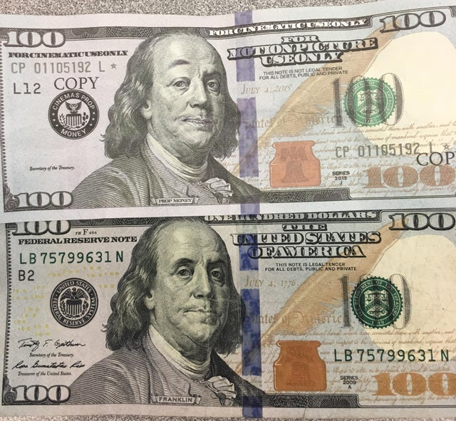
Analogy
?
?
kentwoodhomeguardians.com
https://www.cnbc.com/2015/09/02/can-you-find-the-forgery.html
kentwoodhomeguardians.com
https://www.cnbc.com/2015/09/02/can-you-find-the-forgery.html
https://commons.wikimedia.org/wiki/File:Police_man_ganson.svg
https://www.al.com/news/mobile/2016/08/fake_movie_money_100_bills_app.html

Slide 14
Issues with GANs
Generator collapses
Diminished Gradient
Unbalanced learning rate between Discriminator and Generator
Non-convergence
Finding Nash

Slide 15
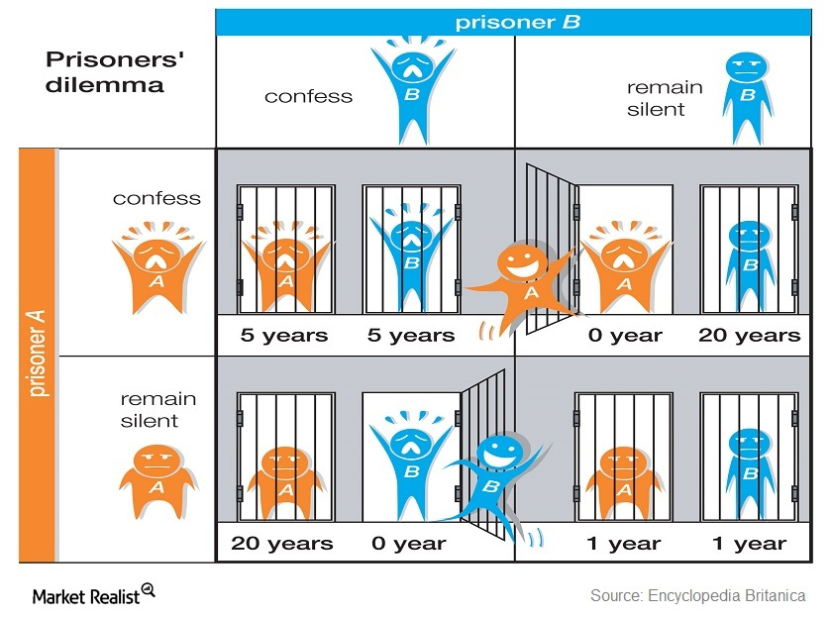
Nash Equilibrium
https://articles2.marketrealist.com/2014/12/falling-commodity-prices-prisoners-dilemma/

Slide 16
Improved Techniques for Training GANs
Finding Nash
By: Tim Salimans, Ian J. Goodfellow, Wojciech Zaremba, Vicki Cheung, Alec Radford, Xi Chen

Slide 17
Historical Averaging and One-sided Label Smoothing
Historical Averaging - Providing the models with “memory”
Parameters (the historical average) is maintained
One-sided Label Smoothing – instead of class values 0 and 1 make them .9 and .1
Reducing adversarial examples

Slide 18
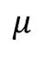
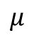
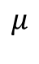
Feature Matching
Instead of taking direct input from the Discriminator, the Generator must generate data to match the statistics of the generated data with the real data.
$$μ$$
$$μ$$
$$μ$$

Slide 19
Minibatch Discrimination
Generator falls into outputting a single point → Discriminator to point similar points to the same direction
Occurs because the Discriminator independently determines authenticity of the sample image to the real image.
Discriminator doesn’t advise to become dissimilar
Now all outputs race toward single point that discriminator currently believes is highly realistic – The collapse
Discriminator realizes single point comes from generator, but gradient descent is unable to separate identical outputs

Slide 20
Minibatch Discrimination

Slide 21
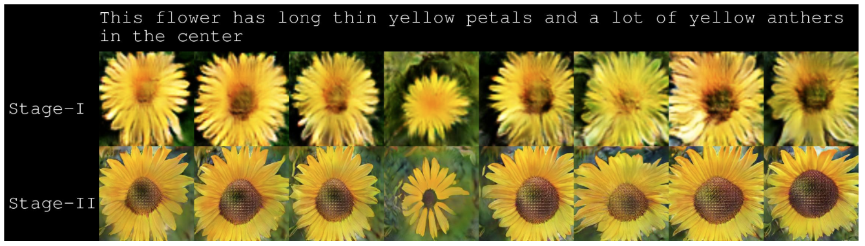
Since 2014 – Text to Image Generation
Zhang et al., 2017 – ICCV 2017

Slide 22
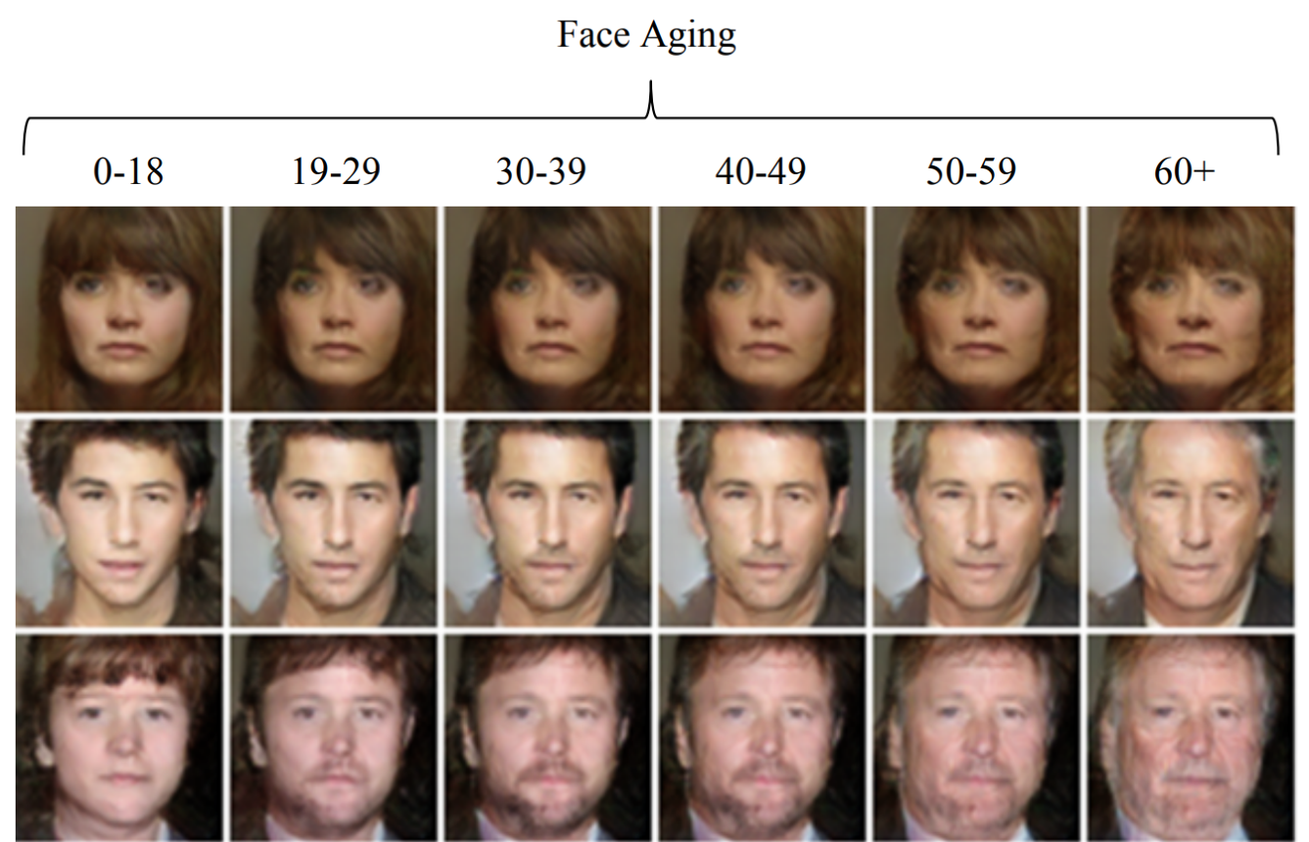
Since 2014 – Aging
Antipov et al., 2017 – Orange Labs

Slide 23
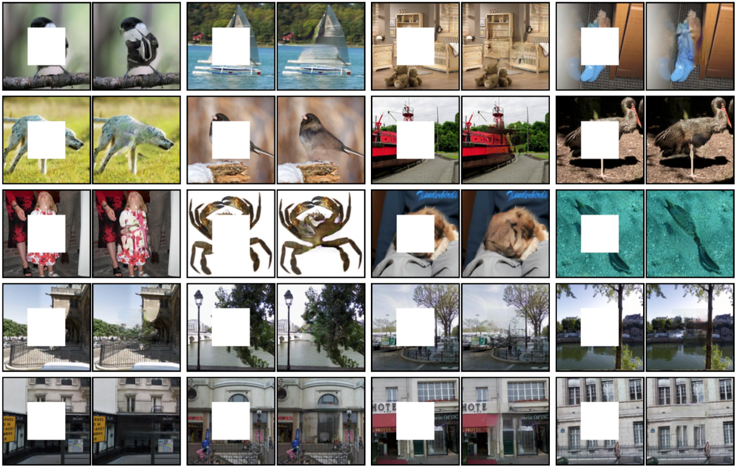
Since 2014 – Image Inpainting
Pathak et al., 2016 – CVPR 2016

Slide 24
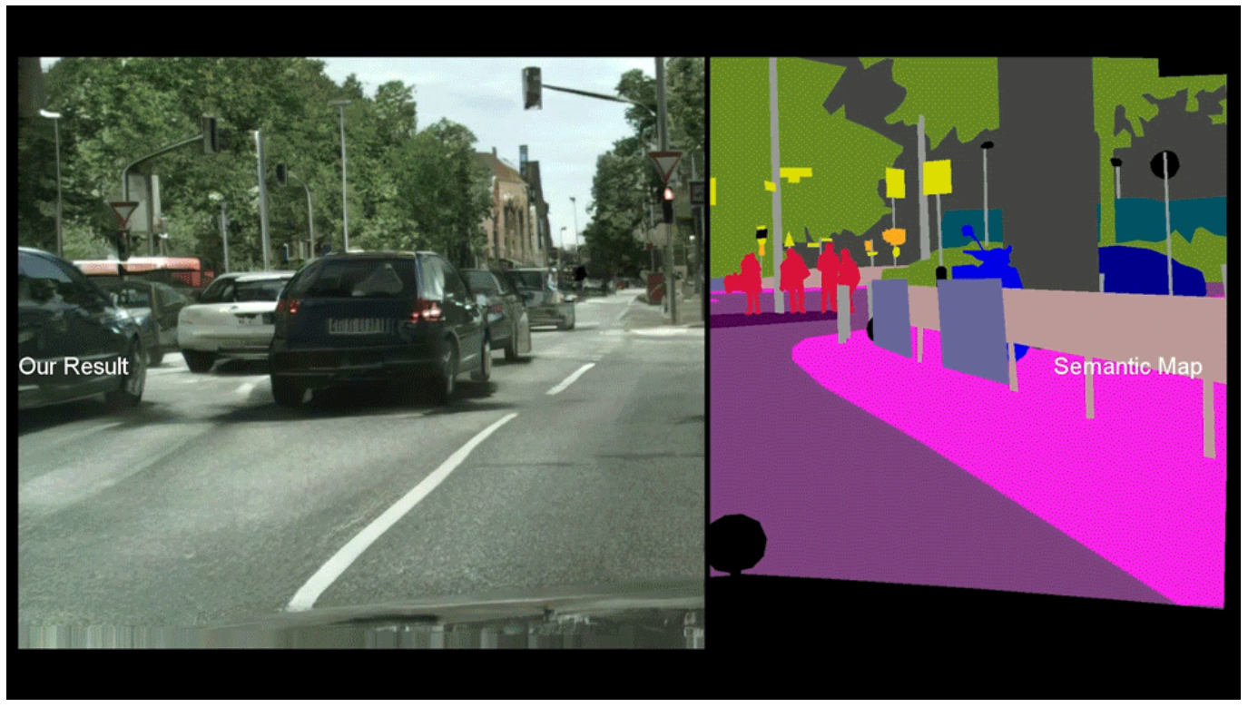
GAN Creative Work – High Resolution Image Synthesis
Wang et al., 2018 – CVPR 2018

Slide 25
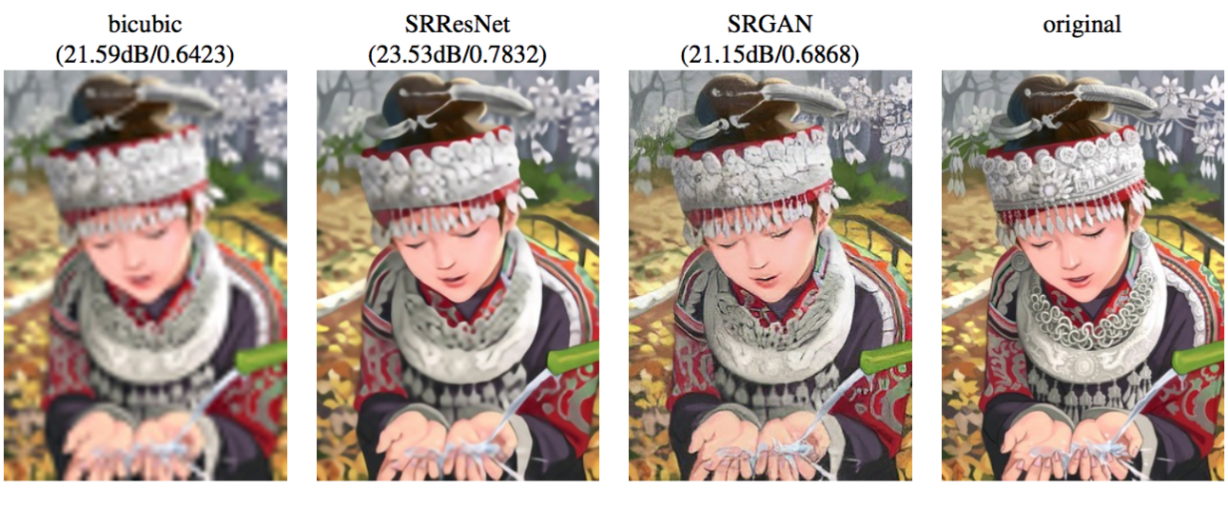
Since 2014 – Super Resolution
Ledig et al., 2017

Slide 26
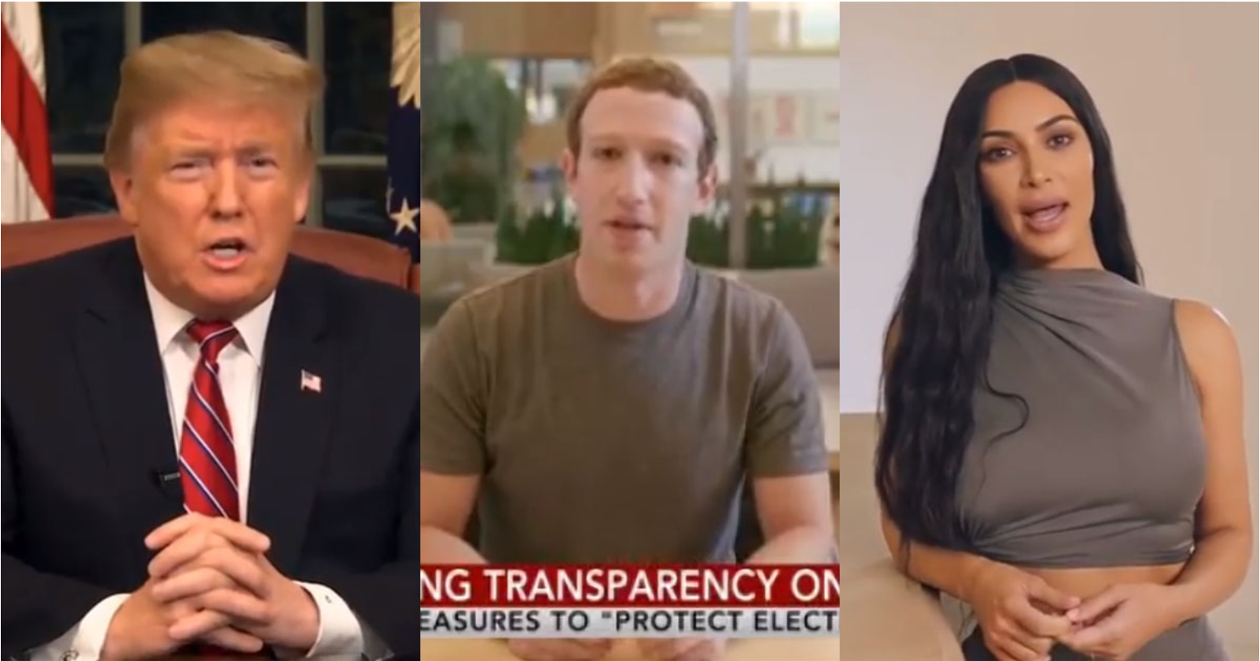

Implications of GANs
Misinformation
Political Influence
Revenge Porn
Falsifying Medical Images
FAKE
https://petapixel.com/2019/06/12/these-deepfakes-of-famous-people-are-testing-facebooks-policies/

Slide 27
Thank You
“GANs and the variations that are now being proposed is the most interesting idea in the last 10 years in ML, … .” – Yann Lecun

Slide 28
Q: What is the metric they measured their images to other images
We estimate probability of the test set data under pg by ﬁtting a Gaussian Parzen window to the samples generated with G and reporting the log-likelihood under this distribution
From GAN paper

Slide 29
Q: What are skip connections
Skip connections are extra connections between nodes in different layers of a neural network that skip one or more layers of nonlinear processing.

Slide 30
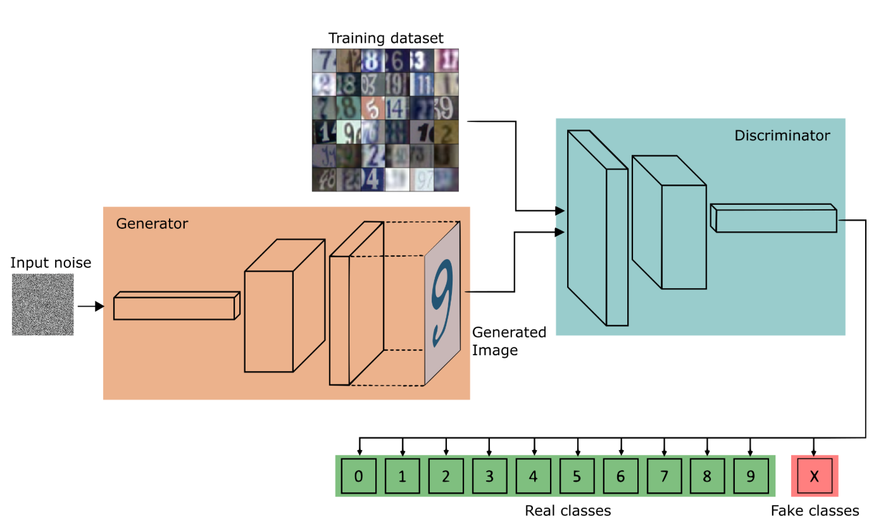
Q: How do we use GANs for Classification
https://towardsdatascience.com/semi-supervised-learning-with-gans-9f3cb128c5e

Slide 31
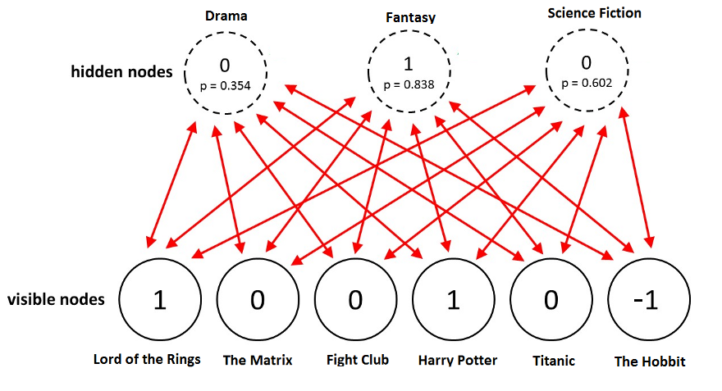
Boltzman Machine

